Slide 1
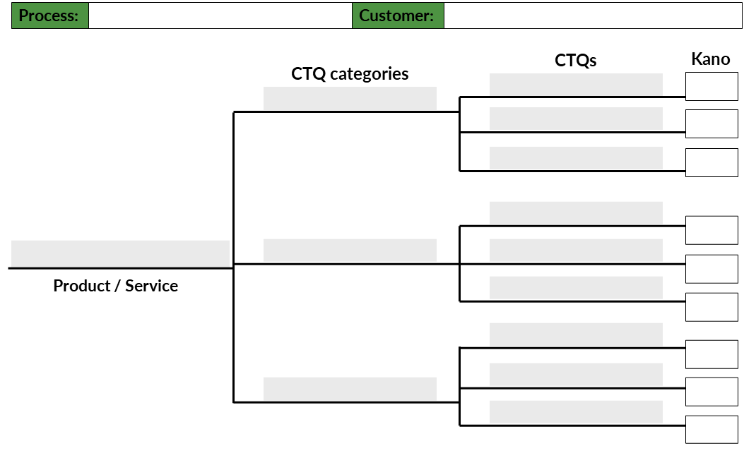
Purpose The Critical to Quality (CTQ) tree is used to identify and capture the needs, wants, and requirements a customer considers when judging your product/service for its quality. It is accompanied by a Kano analysis to further understand and prioritize the complexities of the customers’ needs. This information can then be used to help focus an improvement project on certain aspects of the product/service when developing a solution.
Do
Act
Plan
Study
Critical to Quality (CTQ) Tree + Kano Analysis
2
3
5
6
1
4
Key Components
Product / Service: State the product or service that you are focused on improving
Process: Name the process from which the product/service (Key Component 1) is the output
Customer: State your customer or class of customers you are directly targeting with your product/service
CTQs: List the key wants, needs, and requirements that your customer considers as critical to the quality of your product/service. Ensure that each CTQ is measurable. This should be validated with your customer (e.g. surveys, interviews, focus groups).
CTQs: Provide a category name for the CTQs
Kano analysis: Have your customer categorize each CTQ as one (or more) of the following:
MB (Must Be) - presence does not gain customer attention but absence disappoints the customer
IN (Indifferent) - presence has no effect on the customer
DL (Delighter) - differentiates from the competition
OD (One Dimensional) - the more this requirement is met, the more satisfied the customer
FR (Frustrater) - thought to be a delighter but actually frustrates the customer

Slide 2
Critical To Quality Tree + Kano Analysis
Process:
Customer:
CTQs
Kano
CTQ categories
Product / Service
Kano Analysis Legend =
MB =Must Be
D = Delighter
F = Frustrater
OD=One Dimensional
I = Indifferent

Slide 3
Example Critical To Quality Tree + Kano Analysis: Baking a Custom Cake
Process:
Baking a custom cake
Customer:
Person who places cake order
CTQs
Kano
CTQ categories
MB
Frosting complements cake
Taste
Creative flavor
D
Sweetness level
D/F
Soft crumb
MB
Custom cake
Texture
Creamy frosting
MB
Product / Service
Moist
OD
Legible writing
MB
Smooth frosting
Design
MB
Number of layers
I
Kano Analysis Legend =
MB =Must Be
D = Delighter
F = Frustrater
OD=One Dimensional
I = Indifferent

